Slide 1
Potomac Heritage National Scenic Trail (PHNST) Route at Harpers Ferry NHP

Slide 2
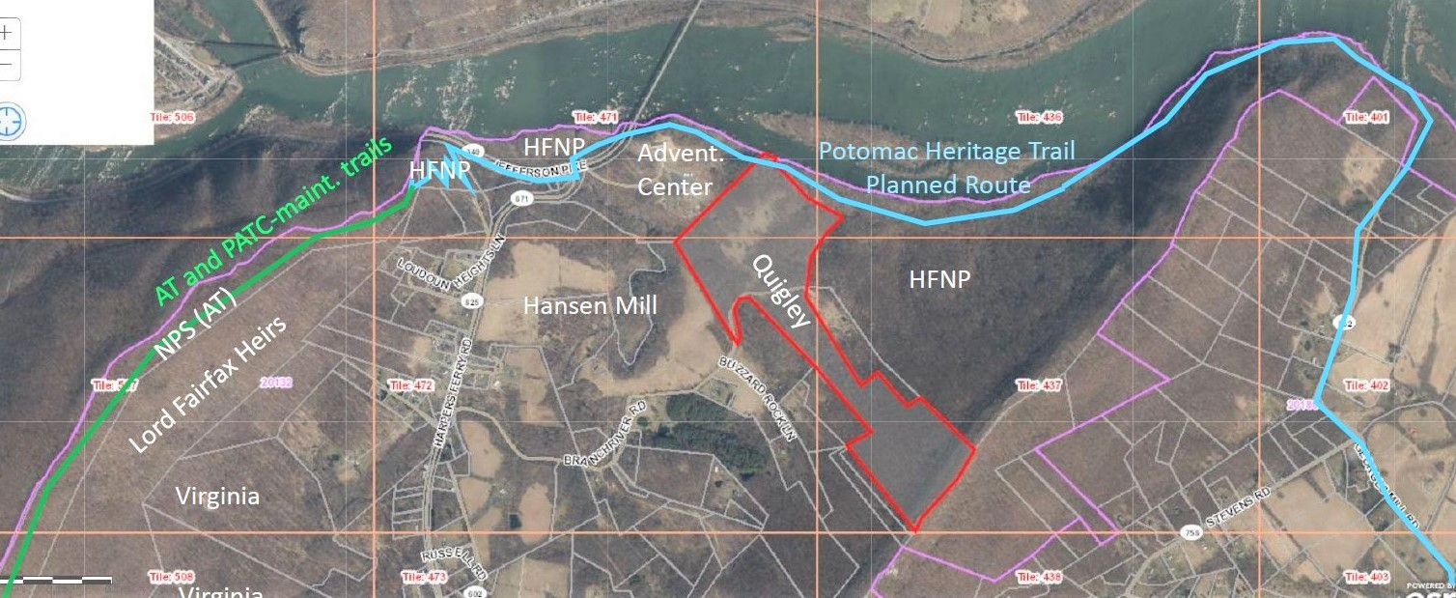
To complete PHNST at Harpers Ferry NHP we need:
2. Revive NPS’s FY 2017 LWCF request for
R.O.W at two properties
Reopen 1990’s route
for Appalachian Trail in HFNP
Pitcher’s Mill
State Park/Appalachian Trail
George’s Mill Road:
Gateway to network
Of Unpaved Roads
Georges Mill Road
3. Establish a trail along the 19th century discontinued road along the river

Slide 3
